Slide 1

World Happiness
Final Results
Nick Reardon
Notes:
Nick Reardon,
Data Scientist

Slide 2
Premise
The world happiness score is rated on a scale of 0 to 10, 10 being the highest possible score (the ideal society).
Based on certain features of a society and/or country, we should be able to predict the closest thing to an ideal society by adjusting the parameters in a data frame.
In the end I will feed the algorithm perfect scores and see what it predicts.
Notes:
A Data frame is an object that data scientists use in the programming language Python in order to perform analysis and prepare the data for use in various different Artificial Intelligence algorithms. It’s essentially what you would see in Excel, although it doesn’t always make as much sense as a typical Excel document. Although it doesn’t always make sense to us, it does make sense to the AI so that’s what is most important.
If the algorithm is good we should see that the predicted degree of happiness will be very high; significantly higher than the rest of the countries.

Slide 3

Understanding the Problem and the Data
In order to predict what the closest thing to an ideal society would be, first we need to understand the problem and the data.
Scale: 0 to 10 & Percentage
Features
Freedom
GDP per capita
Healthy life expectancy
Social support
Freedom to make life choices
Generosity
Perceptions of corruption
Score in Dystopia
Notes:
The problem is that our world is lacking sufficient happiness in many different countries. Countries like middle eastern countries and even our own country (The United States) do not come close to the ideal countries, let alone the societies that are rated as the happiest. People are ignorant to this and I feel that it is my duty to raise awareness.

Slide 4

The Happiest Society: Finland
Egalitarian Society ^{[1]}
GDP per capita: 9.8
Social support: 95.4%
Healthy life expectancy: 72 years
Freedom to make life choices: 94.9%
Generosity: 9.8%
Perceptions of corruption: 18.6%
Score in Dystopia: 2.430
Notes:
Egalitarianism, aka equalitarianism is a school of thought within political philosophy that builds from the concept of social equality, prioritizing it for all people.
95.4% of the citizens of Finland think that their necessities are sufficiently supported by their government
The have an average life expectancy of 72 years.
94.9% of the citizens believe that they are free to make their own decisions in life
Interestingly only 9.8% of the citizens feel the generosity of others.
But, most people do not think that there is corruption in their government
The score of dystopia, which is great suffering or injustice, is relatively low having an average of 2.43 on a scale of 0 to 10.

Slide 5
The Top 3 Happiest Societies
Egalitarian^{[1]}
Unitary State^{[2]}
Semi-direct Democracy^{[3]}
The top 5 happiest countries consist of these types of societies.
Finland
Denmark
Switzerland
Iceland
Netherlands
Notes:
We discussed Egalitarianism in the previous slide.
A unitary state is a state governed as a single entity in which the central government is ultimately supreme.
In semi-direct democracy, representatives administer daily governance, but citizens keep the sovereignty, being able to control their governments and laws through different forms of popular action.

Slide 6
The “Data” Scientific Method
The idea behind data science is that you can actually perform experiments through the Scientific Method using just data and different forms of pattern recognition. This essentially captures the scientific method through the use of various methods in Artificial Intelligence that will “play out” the controlled experiment and prove or disprove your hypothesis.
Notes:
Data science is a new scientific field that thrives in extracting meaning from data to improve understanding. It represents an evolution from other analytical areas such as statistics, data analysis, business intelligence, and so on.

Slide 7
Hypothesis and Validation
In this experiment we start with the hypothesis that we can fabricate the ideal society by adjusting the parameters that we feed to the algorithm. By making all of the features perfect we can both see whether it will provide the hypothetical citizens of this country with a more happiness than any other country but also we will be validating that these AI techniques are also accurate with their predictions.
Notes:
Freedom
GDP per capita
Healthy life expectancy
Social support
Freedom to make life choices
Generosity
Perceptions of corruption
Score in Dystopia

Slide 8
What method did I use?
In AI there is a growing field by the name of “Deep Learning”. Deep Learning aims to replicate the function of the mind, even by creating structures that are eerily similar to the structures in our own brain.
While this may or may not be true for our own minds, the fact of the matter is that they work. So, whether this is representative of the biological norm or not, we can still use this particular method to carry out our experiments.
So, what was used?
In this experiment I decided to use Neural Networks for something called Regression (a prediction of a continuous variable).
Neural Networks are state-of-the-art and often have the best accuracy of any other algorithm used by AI practitioners. The outcome of this experiment was no less significant.

Slide 9
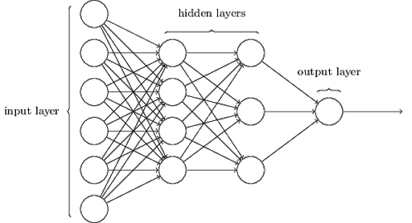
Visualizing a Neural Network
To understand a Neural Network, first we must see the architecture.
By looking at this visual we can see that there is somewhat of a resemblance to what we expect to see in our brains. Each circle is referred to as a “neuron” or a “unit [of knowledge]”. They all contain representations of the data, whatever those representations may be, and weights associated with the connections which are supposed to represent the strength of the connections between neurons.
Notes:
Like I said, whether this is representative of the biological norm is up for debate, but the simple fact of the matter is that it works.

Slide 10
Curiosity Crashed the Car
While Neural Networks are very important, useful, and frankly impressive, there are drawbacks to their use.
Like humans, they are not perfect. They can be wrong even if they do outperform us in typical tasks.
They should be scrutinized intensely depending on the consequences of using them.
More and more automotive companies are implementing the “auto-pilot” feature in their vehicles now. This relies on Neural Networks and, while they can outperform humans, they are not always accurate. Sometimes they make a mistake and, hence, there will be an accident (as there already has been).

Slide 11
Are they safe?
First, make sure that the consequences of failure are clear in whatever domain you apply them to.
In Ad placement, the consequence of a person not clicking on the advertisement is minimal, you can only lose so much money. On the other hand, the consequence of getting it right is the holy grail. So, use the Neural Networks.
Having them drive a car is a big step in trusting these algorithms.
Testing them repeatedly in many different environments and under many different situations is imperative. When the consequence is death then the algorithm will require a lot more scrutiny and people will have to be aware of the chance of something going wrong.
With the right explanation people will trust an algorithm if it outperforms humans themselves. In other words, an accident by a Neural Network is far less common than an accident by any driver, let alone a distracted driver.

Slide 12
How do we make sure that they are safe?
In this experiment, the consequence of an inaccurate prediction is basically non-existent. But, if we had to make sure that it was safe for deployment we would do the following.
Measure the loss
Measure the accuracy
Train the algorithm with training data
Test the algorithm with testing data
Visualize the data
Use various metrics to further look into the accuracy
In this case we use MSE (mean squared error)

Slide 13
Steps to Experiment with the Data
Build a Neural Network.
Separate the data into training and test sets.
Train the Neural Network on the training data.
Allow the algorithm to “learn” from the data.
Take a look at the results using various metrics.
Mean Squared Error
Mean Absolute Percentage Error
Notes:
There’s no right way to build a Neural Network, but there are many different wrong ways. Different functions provide better or worse results depending on what the goal of the experiment is.
The Neural Network learns from the data by adjusting the strength of its connections and finding ways to improve the accuracy while decreasing the loss. This means that it will try to learn the best way to carry out the task without only knowing the data that it was trained on.

Slide 14
The Architecture of Our Network
The Network selected consisted of 3 layers.
There are 7 input units for 7 features in our data
There are 20 hidden units (the layer between the input and the output)
Because we are predicting a continuous variable, there is only one unit in the output layer

Slide 15
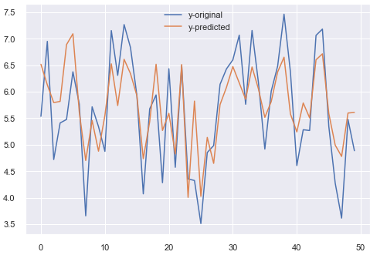
Results
I think that, by looking at this visualization of our results, we trained the network very well and, judging by our metrics, we can use it reliably for making predictions.
Notes:
It turns out that after training the Neural Network, it was only typically off by .42. That is a mean absolute percentage error of 4.2%.

Slide 16

So, what’s the verdict?
By taking our features and making them perfect, the Neural Network predicts that our ideal society will have a happiness score of 9.68.
That’s a happy society!

Slide 17
Acknowledgements
My professor, Brett Werner. I learned a lot in this course and I believe that you did a great job at teaching while having qualities that are favorable (such as kindness and thoughtfulness).
My peer, Ben Brock. Thank you for building my confidence in pursuing this degree. Although it hasn’t been easy I have always looked up to you in becoming a success in this field and working closely with others.
My wife, Maya. Thank you for pushing me to do this. I have learned a lot and, although this hasn’t been the easiest journey, through the ups and downs I always cherish your love and support. Being able to talk to you about what I know is so important to me, so having someone as smart as you is an honor and a blessing.

Slide 18
References
Egalitarianism Wikipedia, 2021, https://en.wikipedia.org/wiki/Egalitarianism
Unitary State Wikipedia, 2021, https://en.wikipedia.org/wiki/Unitary_state
Semi-direct Democracy Wikipedia, 2021, https://en.wikipedia.org/wiki/Semi-direct_democracy
Towards Data Science, Ludovic Benistant,2021, https://towardsdatascience.com/is-data-science-a-real-science-2920bb2529aa
Kaggle, 2021, https://www.kaggle.com/ajaypalsinghlo/world-happiness-report-2021

